Slide 1
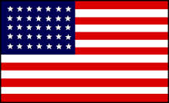
Chapter 17 “The Tide of War Turns”
17.3 The North Wins

Slide 2
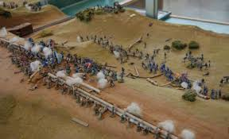
1862 Events
September - Battle of Antietam – Victory for the Union
December - Burnside makes a disastrous attack at Fredericksburg – Victory for the Confederacy

Slide 3
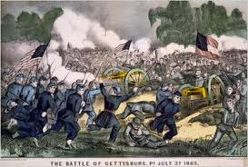
1863 Events
May – Lee defeats General Joseph Hooker at Chancellorsville - Confederate victory
July- Union wins at the Battle of Gettysburg
- Grant defeats the Confederacy at the Siege of Vicksburg
November – Lincoln delivers the Gettysburg Address

Slide 4
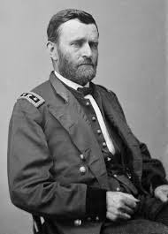
1864 Events
March – Lincoln puts Grant in charge of the entire Union army
May – Battle of the Wilderness
June- Battle of Cold Harbor
September – Sherman takes Atlanta
November – Lincoln is re-elected POTUS
December – Sherman takes Savannah

Slide 5
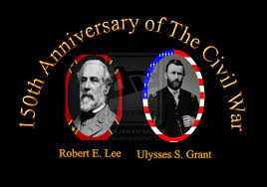
Union Successes at Gettysburg and Vicksburg
The North begins to win the war
Britain gave up thoughts of supporting the South in the war
Lincoln found a man willing to fight General Lee in General Grant
The Siege at Vicksburg fulfilled a major part of the Anaconda Plan
1/3 of Lee’s men were killed or wounded at Gettysburg

Slide 6
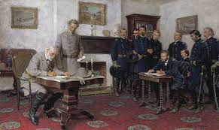
1865 Events
April – The Union army takes Richmond
April – Lee surrenders at Appomattox Court House

