Slide 1
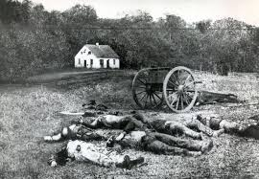
Chapter 16 “The Civil War”
16.3 “No End in Sight”
Pages 493 – 497

Slide 2
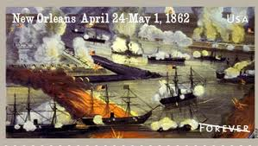
Union Victories in the West
The battles of:
Fort Henry
Fort Donelson
Shiloh
New Orleans
Antietam

Slide 3
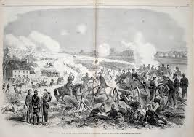
Confederate Victories in the East
The Battles of :
Seven Day’s
Second Battle of Bull Run

Slide 4
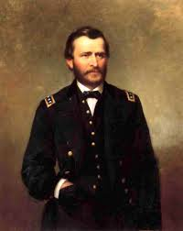
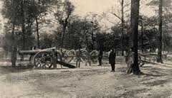
Battle of Shiloh
General Grant was the Union leader
Johnston and Beauregard were commanders of the Confederacy
Victory for the Union
Johnston was killed.
General Tecumseh Sherman becomes a (U) hero.
Very high causalities and muddy conditions due to a storm the night before the battle.
Each side lost 25% of their troops at this battle.

Slide 5
Battle of Antietam
McClellan lead the Union army.
Lee lead the Confederate army.
The Union won based on a draw.
The Battle of Antietam was the bloodiest day in our nation’s history.

